Slide 1
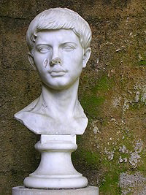
Publius Vergilius Maro Virgil

Slide 2
Virgil’s young life
Born in Andes in Gaul
Descended from early Roman colonists
Received first education at 5 years old
Finally went to Rome to study rhetoric, medicine, and astronomy
Abandoned these for philosophy

Slide 3
Virgil’s works
Wrote many poems as an adolescent, not considered very good by scholars.
Eclogues- 42 BCE. Collection of pastoral (natural) and love poems.
Georgics- 37 BCE. Virgil describes in detail how to run a farm.

Slide 4
The Aeneid
Written between 29-19 BCE, near the end of Virgil’s life.
Commissioned by Augustus, who hoped to link his lineage to the founding of Rome.
Epic poem

Slide 5
What is epic poetry?
9 characteristics
Begins in medias res
Has a vast setting
Begins with an invocation to a muse
Contains a statement of theme
Uses epithets for major characters
Contains long lists
Contains long formal speeches
Plot relies on divine intervention
Contains heroes

Slide 6
The Aeneid
Follows Aeneas’ journey from the sacked city of Troy after the events of the Trojan War
Forced to Carthage due to a storm, where he meets Dido, queen of the Carthaginians. She falls in love with him, and he intends to stay, but Jupiter, king of the gods, reminds him that he has a destiny to found a new city, so he leaves. When he does, Dido commits suicide.
Aeneas’ father dies in book V, and so in book VI Aeneas journeys to hell in order to ask his father what the destiny of Rome is.

Slide 7
Aeneas’ journey

